Slide 1
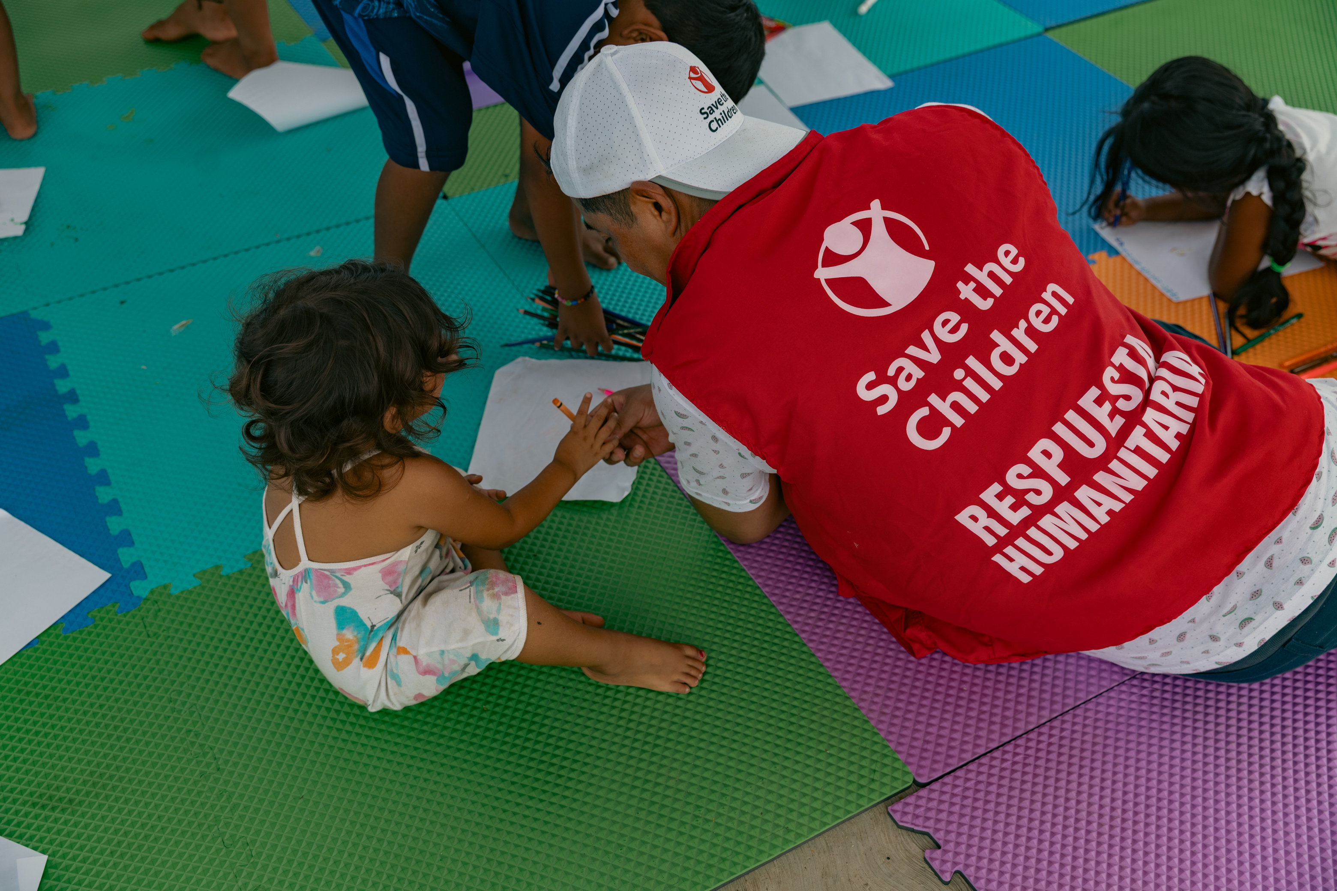
World Humanitarian Day
August 19th

Slide 2


Warm up challenge!
Grab a piece of paper and set a timer for 3 minutes.
You can do this with a buddy or as a solo challenge.
How many words with three letters or more can you make using the letters in:
HUMANITARIAN
  e.g train

Slide 3
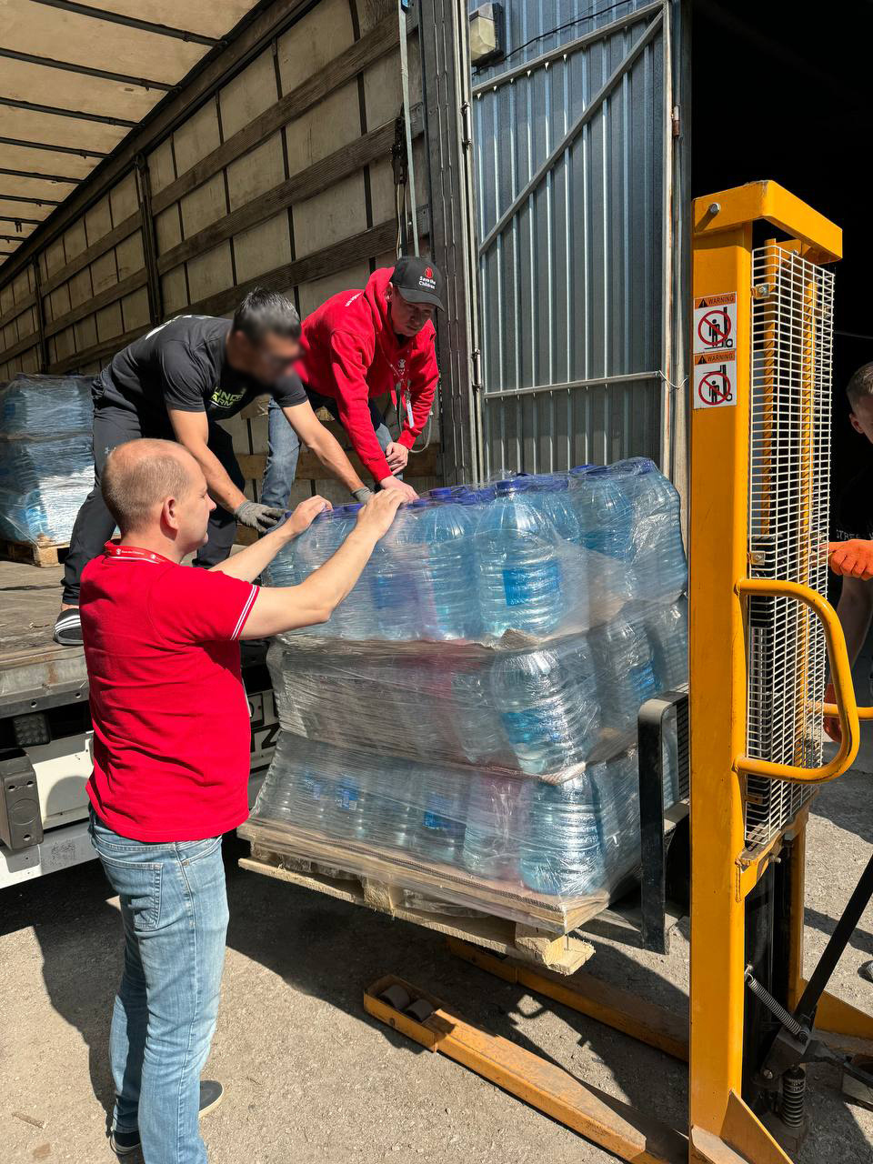


What is a humanitarian?
Humanitarians are people who have chosen to help others in time of crisis - they may be volunteers or paid workers.
On August 19th World Humanitarian Day takes place and is a chance to celebrate and learn more about the mahi that aid workers do around the world, especially during times of global crisis.
This can be a dangerous job at the front line of crisis, but humanitarians do what they do to help others.
Save the Children humanitarian workers delivering water to a humanitarian coordination centre in Ukraine

Slide 4








Think, Pair, Share
Discussion Questions
What might being a humanitarian look like?
Can you think of any humanitarians?
Can you think of any situations around the world right now where humanitarians may be involved with providing aid?
How does this connect to the topic of children’s rights?
What kind of skills might someone need to be a humanitarian?

Slide 5

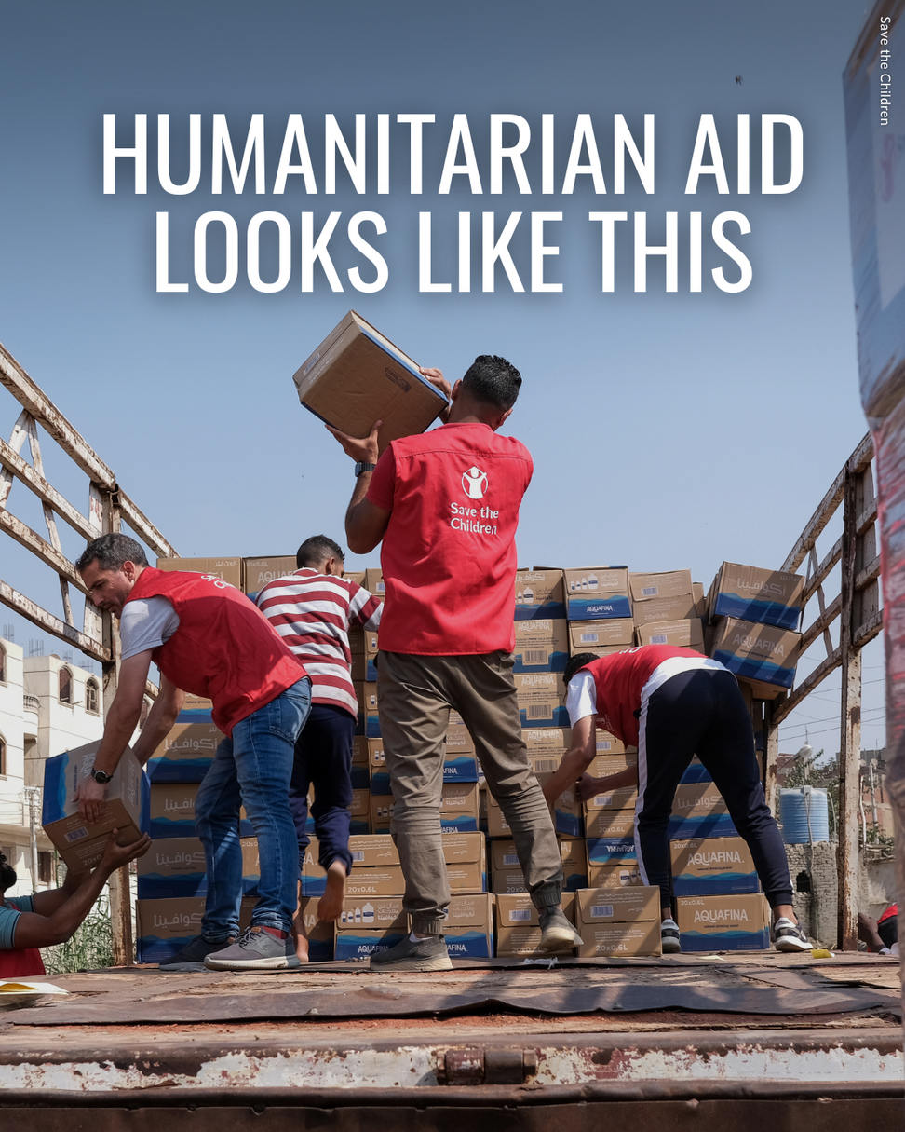
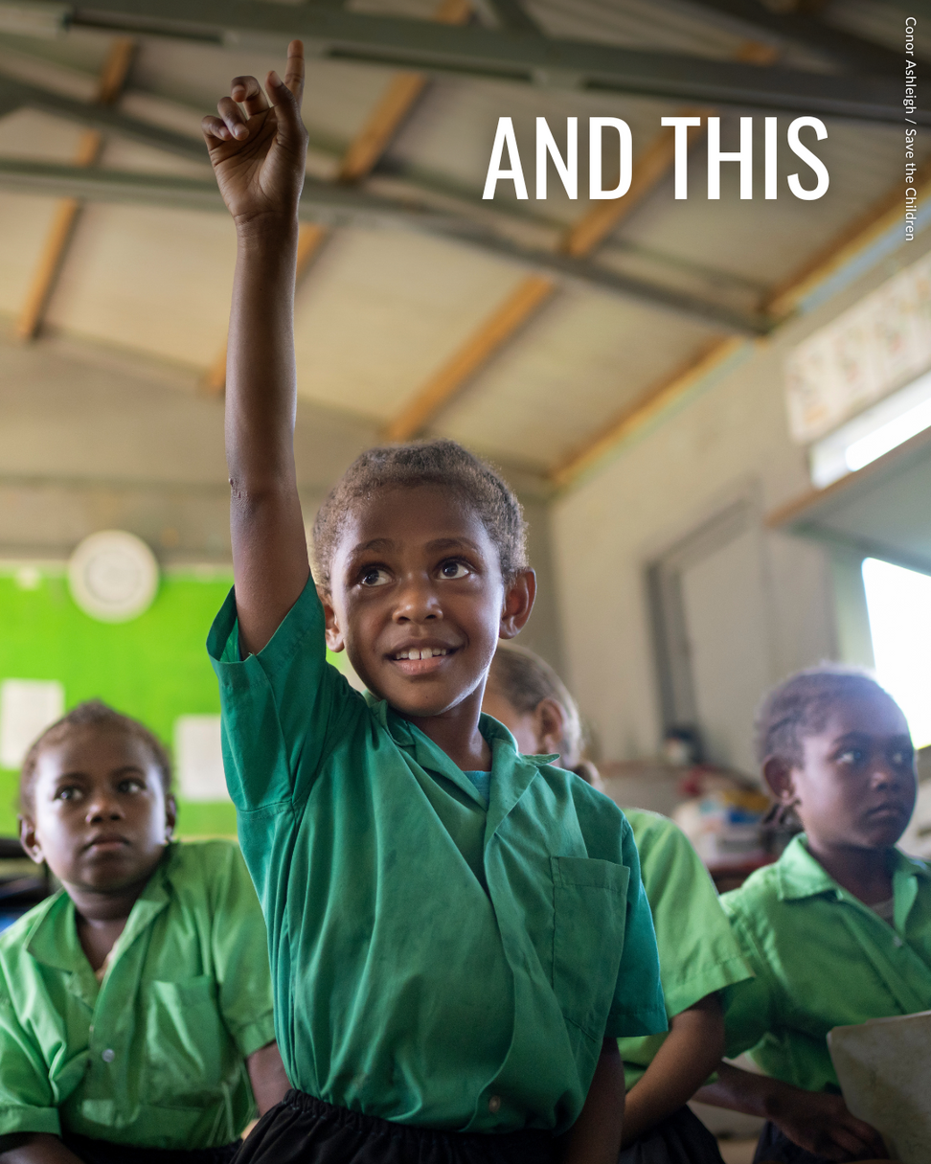

Slide 6

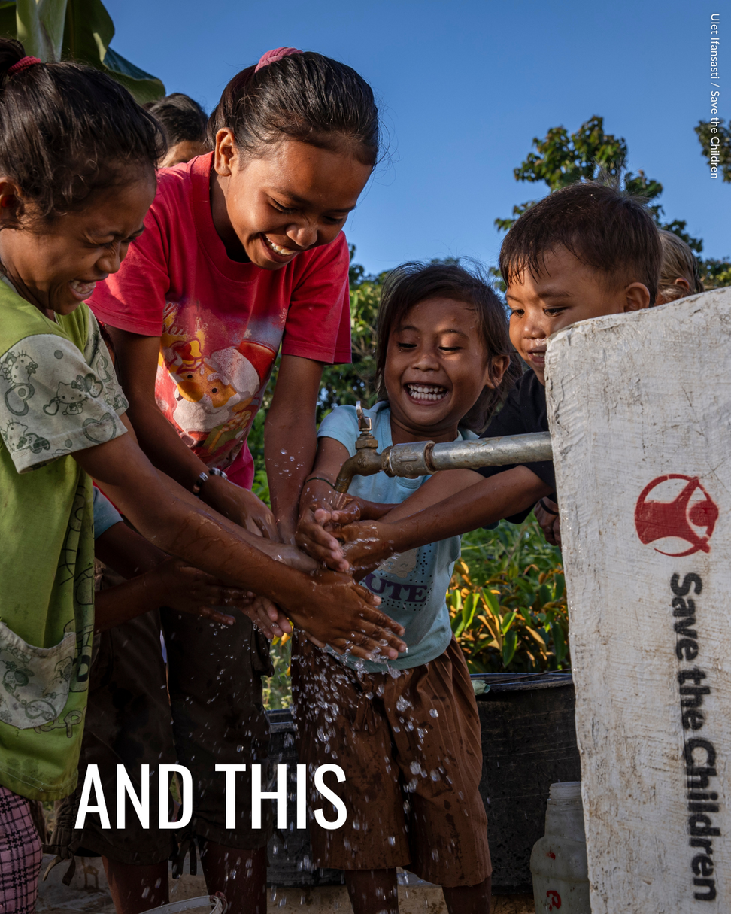
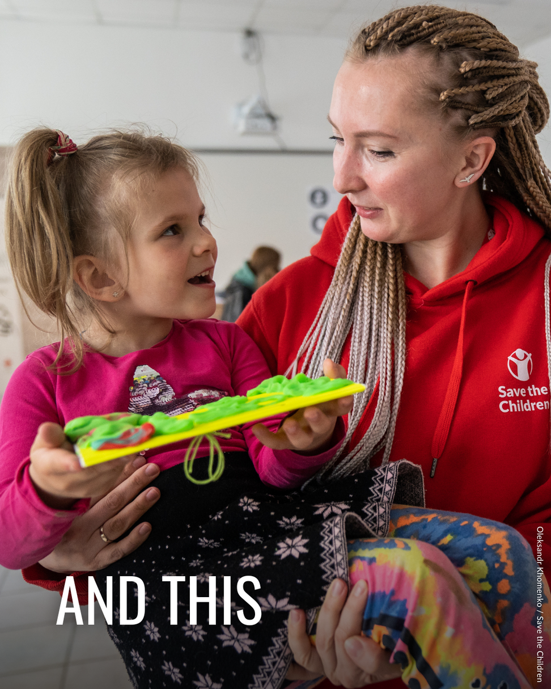

Slide 7

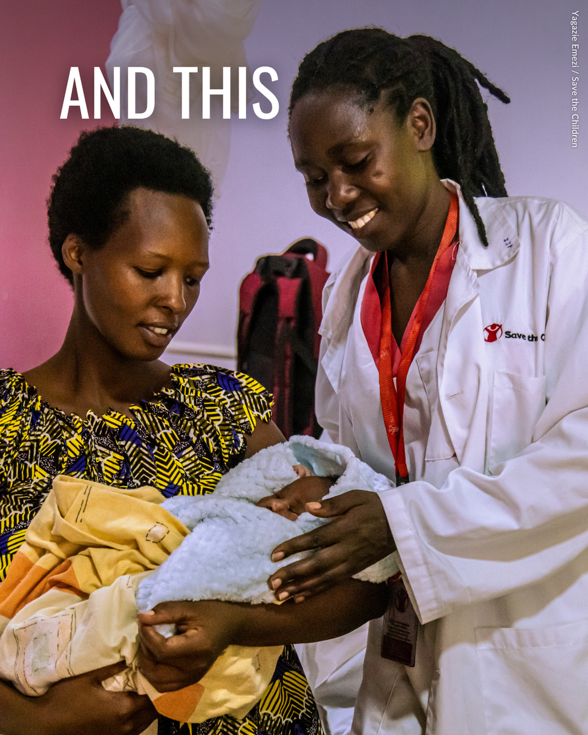
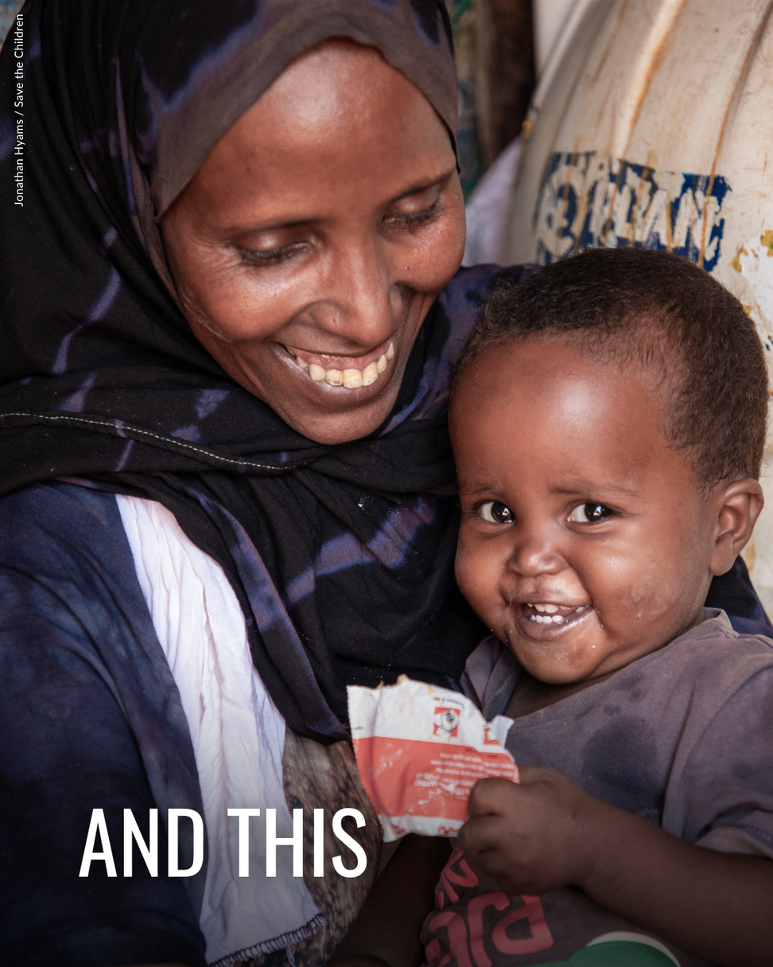

Slide 8


Extra for Experts:
  Write a description of what you think is happening in each of the previous images
  Create your own poster or video to teach others about humanitarian work.
  Research and learn more about humanitarians and find one interesting person or organisation who you want to report back to your class about.
Please send any comments/suggestions or student work to us at education@scnz.org.nz - we would love to hear from you!

